Slide 1
DrEaMing CQUIN update for 23/24

Slide 2
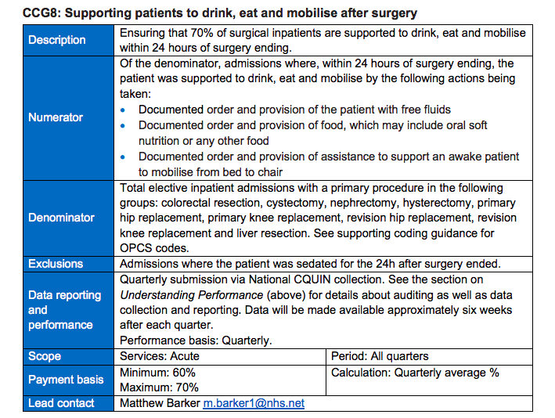
Introductory CQUIN: 22/23
Major resections and replacements
70% target

Slide 3
Rationale

Slide 4
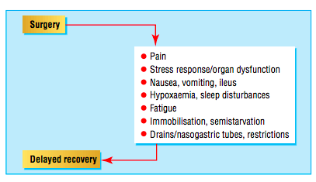
ERAS: early UK experience
Enhanced recovery compliance: More is better → reduced length of hospital stay

Slide 5
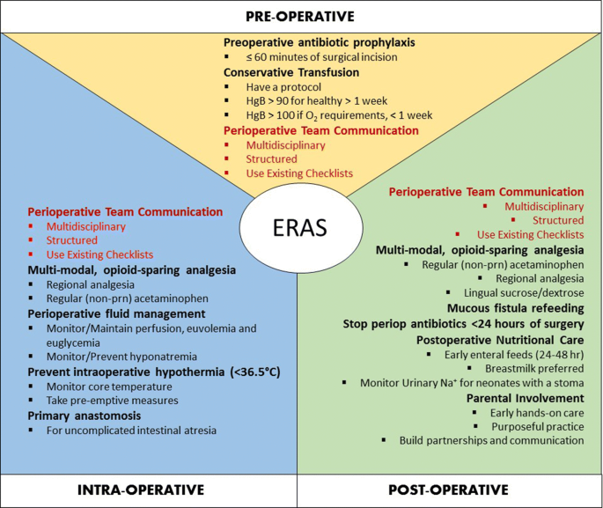
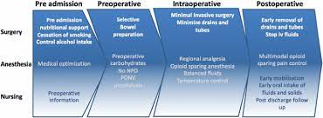
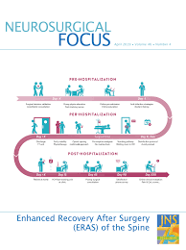
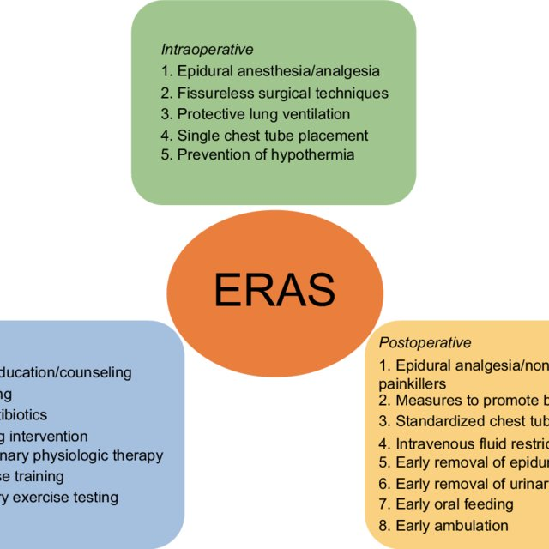

Slide 6
Enhanced recovery elements: 3 groups
Stuff which has become part of the fabric of care:
Temperature management
Antimicrobial prophylaxis
Stuff which is too controversial to get over / get consensus on
Goal directed fluid optimisation
Analgesia techniques for specific surgeries
Stuff which we should all be doing but can be hard and therefore variation still exists
Early mobilisation; early return to normal homeostasis

Slide 7
Enhanced recovery elements: 3 groups
Stuff which has become part of the fabric of care:
Temperature management
Antimicrobial prophylaxis
Stuff which is too controversial to get over / get consensus on
Goal directed fluid optimisation
Analgesia techniques for specific surgeries
Stuff which we should all be doing but can be hard and therefore variation still exists
Early mobilisation; early return to normal homeostasis

Slide 8
Drinking, Eating and Mobilising within 24h of surgery: DrEaMing
Drinking free fluids
Eating soft diet
Mobilising with support of one person

Slide 9
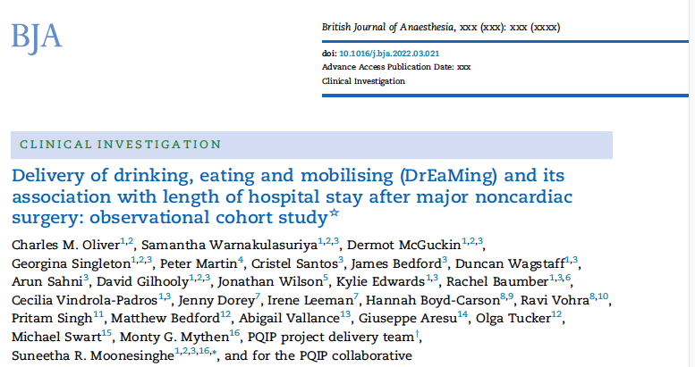

Slide 10
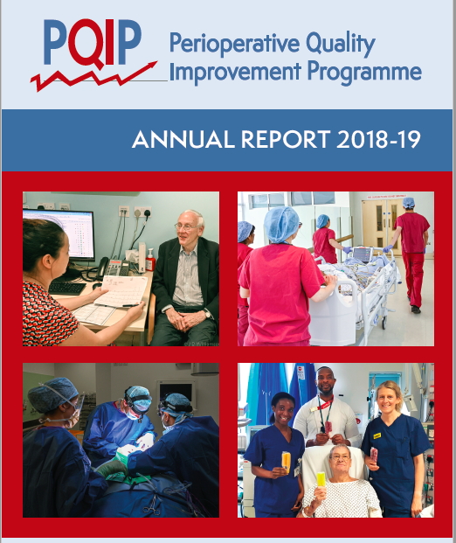
PQIP: Improving outcome using data

Slide 11
DrEaMing and postoperative complications
General postoperative complication rate: 25.4%
37% in patients who did not DrEaM within 24h
17% in patients who did DrEaM within 24h
Specific complications higher in patients who did not DrEaM within 24h
pulmonary (3.7% vs. 1.9%)
cardiovascular (4.8 vs 1.9%)
gastrointestinal (20.7 vs. 6.3%)

Slide 12
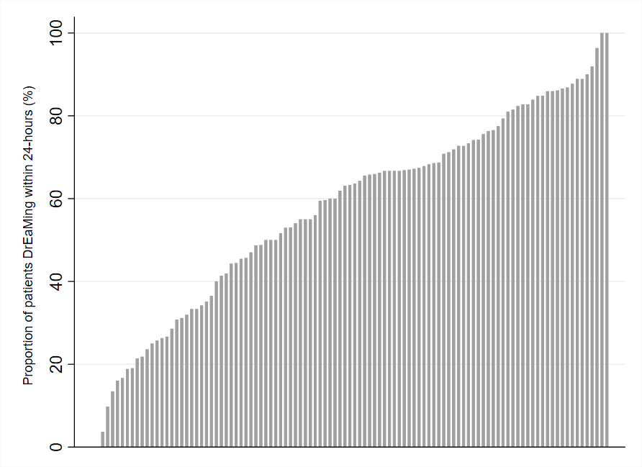
Homogenous group of colorectal procedures (n=7211)

Slide 13
 | Quintile
 | 1 | 2 | 3 | 4 | 5
Proportion of cases achieving DrEaMing (%) | 0 – 33 | 34 – 54 | 55 – 67 | 68 - 81 | 82 - 100
Number of patients (N=7211) | 1136 | 1266 | 1412 | 1974 | 1423
LOS (6 (4-9)) | 7 (5-9) | 6 (4-8) | 6 (4-8.5) | 6 (4-9) | 5 (4-8)
Incidence of major postoperative morbidity (%) | 23.3 | 24.1 | 24.4 | 22.3 | 21.2
Hospitals with the highest proportion of DrEaMers:
2 day shorter median LOS than the hospitals with the lowest proportion of DrEaMers

Slide 14
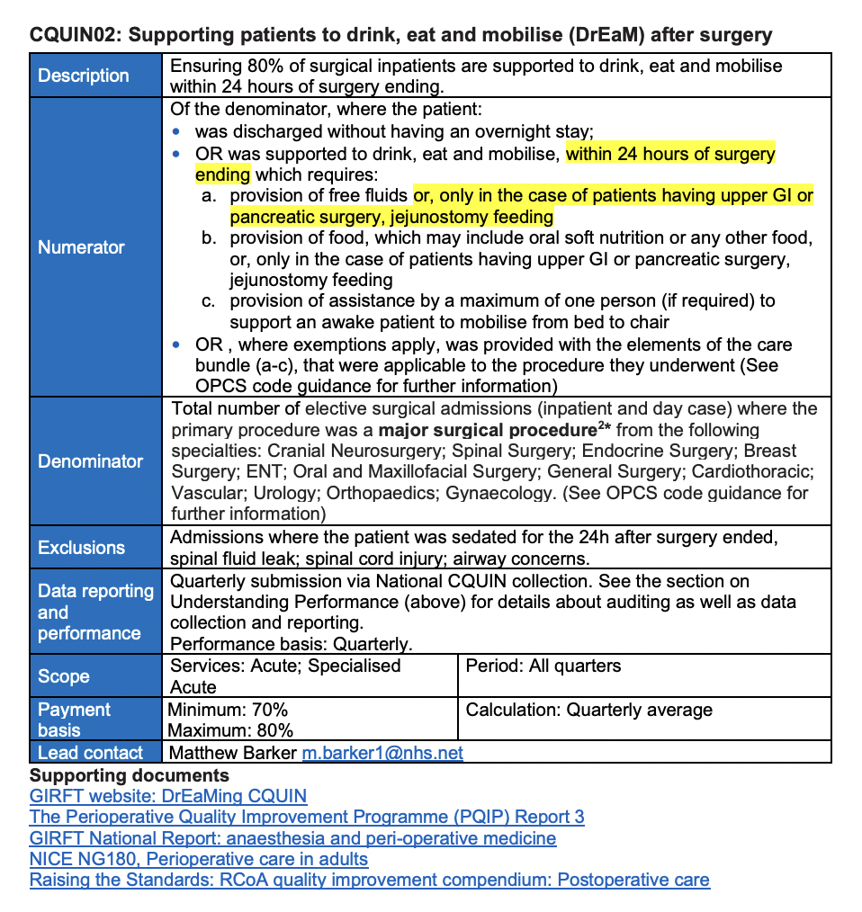
Expanded CQUIN
for 23/24:
More procedures
Higher target

